Slide 1
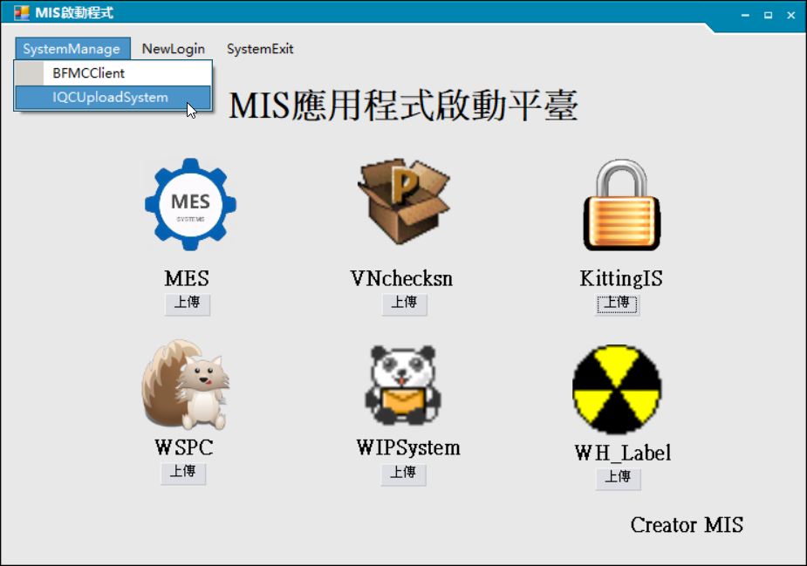
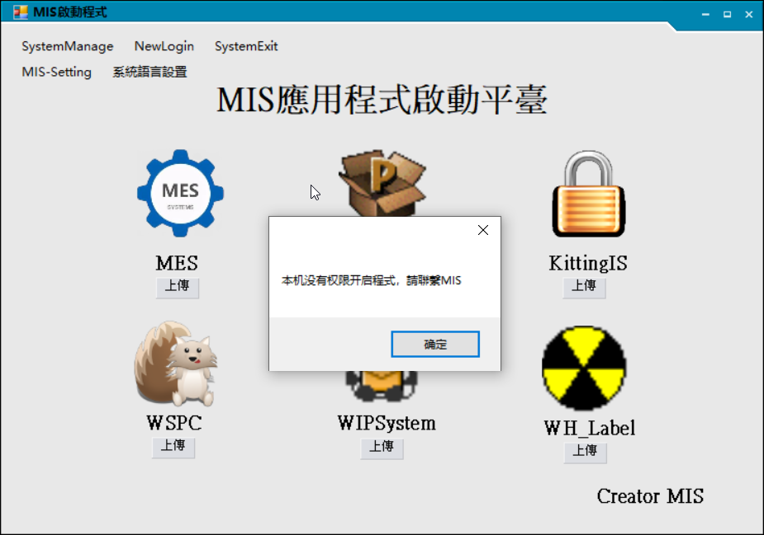
1.选择IQCUploadSystem程序，若提示没有权限，请找IT开通，提供电脑IP 1. Select the IQCUploadSystem program. If you receive a permission error, please contact your IT department to activate it and provide your computer's IP address.

Slide 2
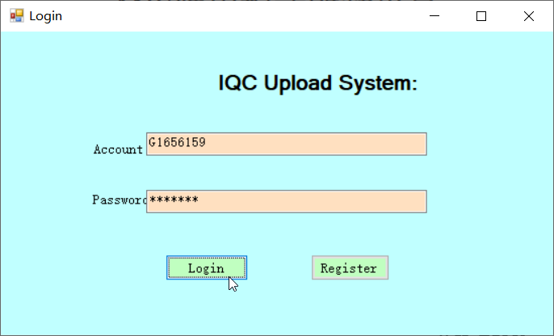
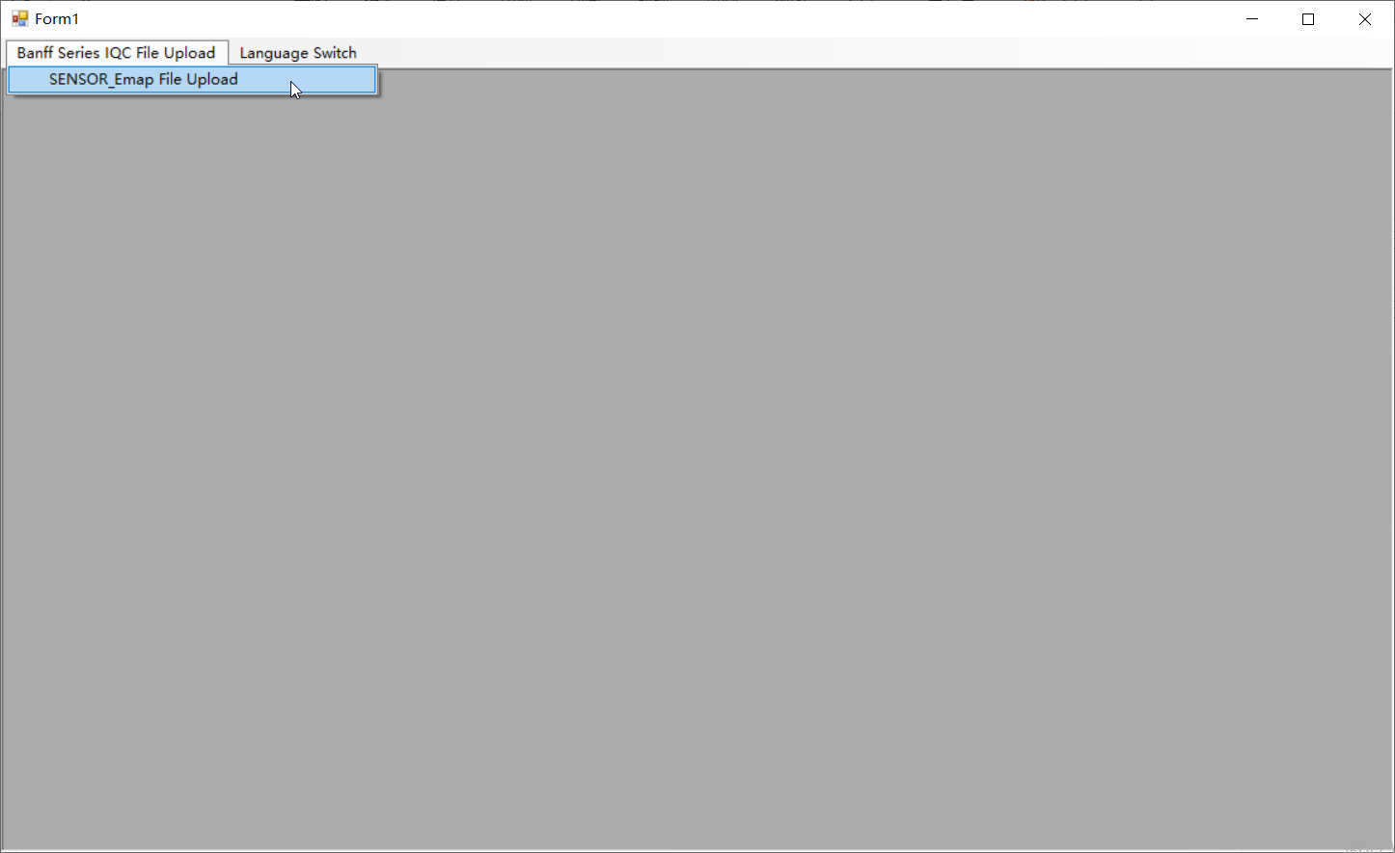
2.输入账号密码后，点击Login 2. After entering your username and password, click Login.
3.点击Sensor_emap File Upload 3. Click Sensor_emap File Upload

Slide 3
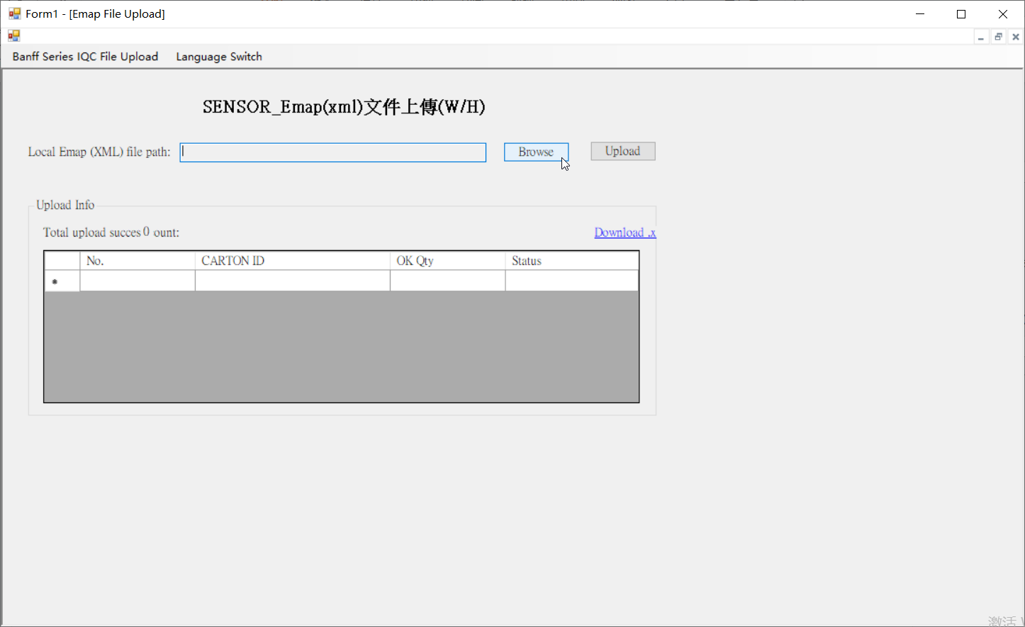
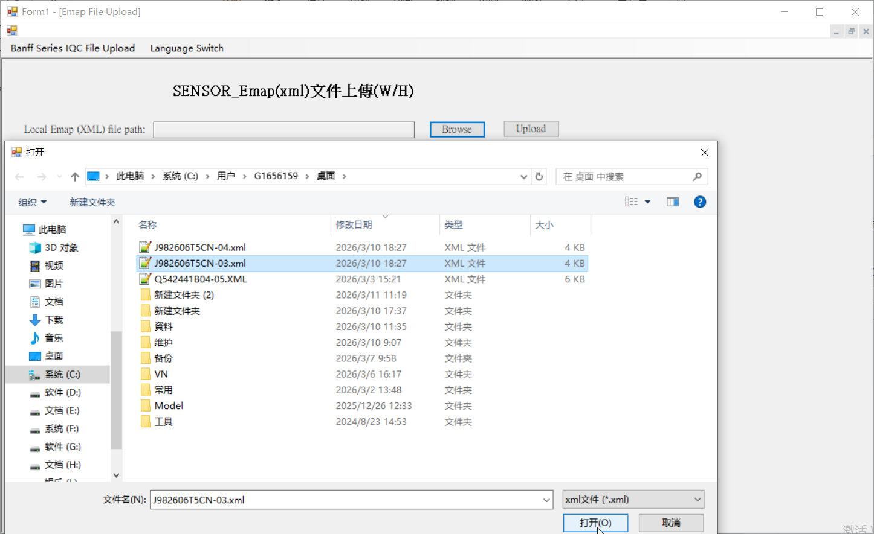
4.点击Browse 4. Click Browse
5.选择要上传的Emap文件，点击打开 5. Select the Emap file to upload and click Open.

Slide 4
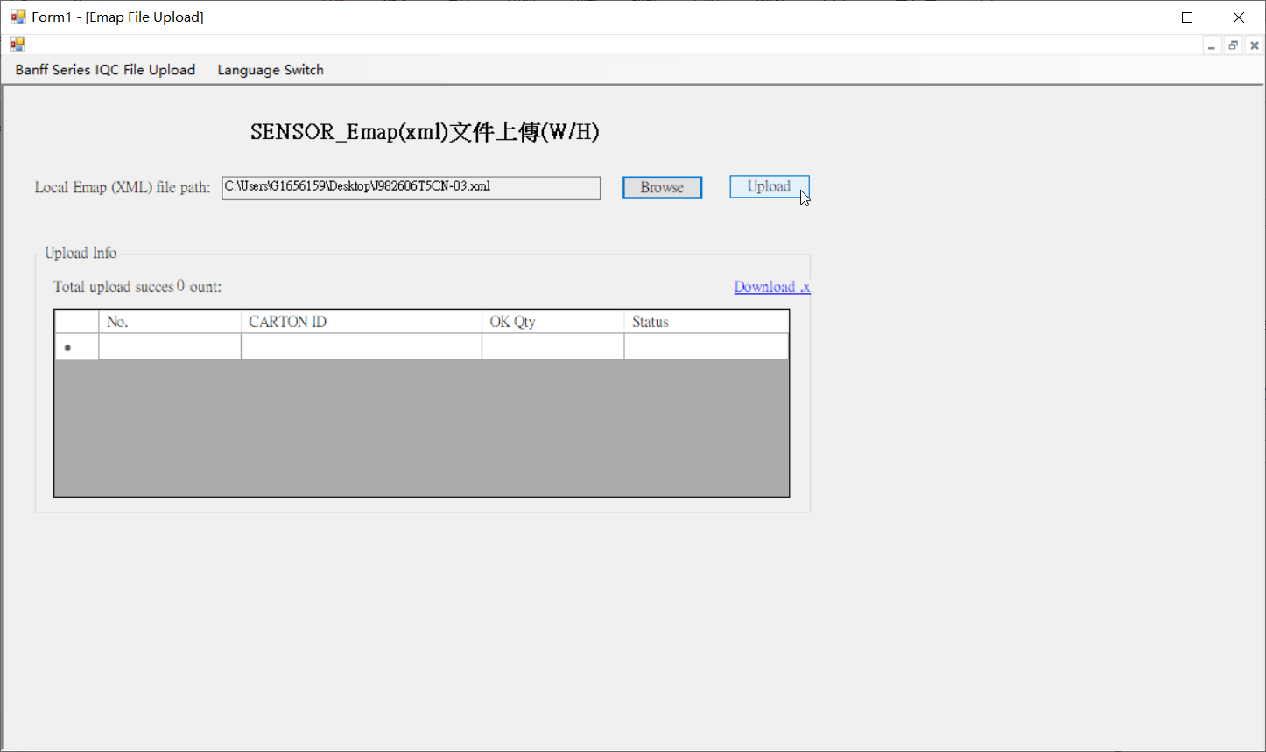
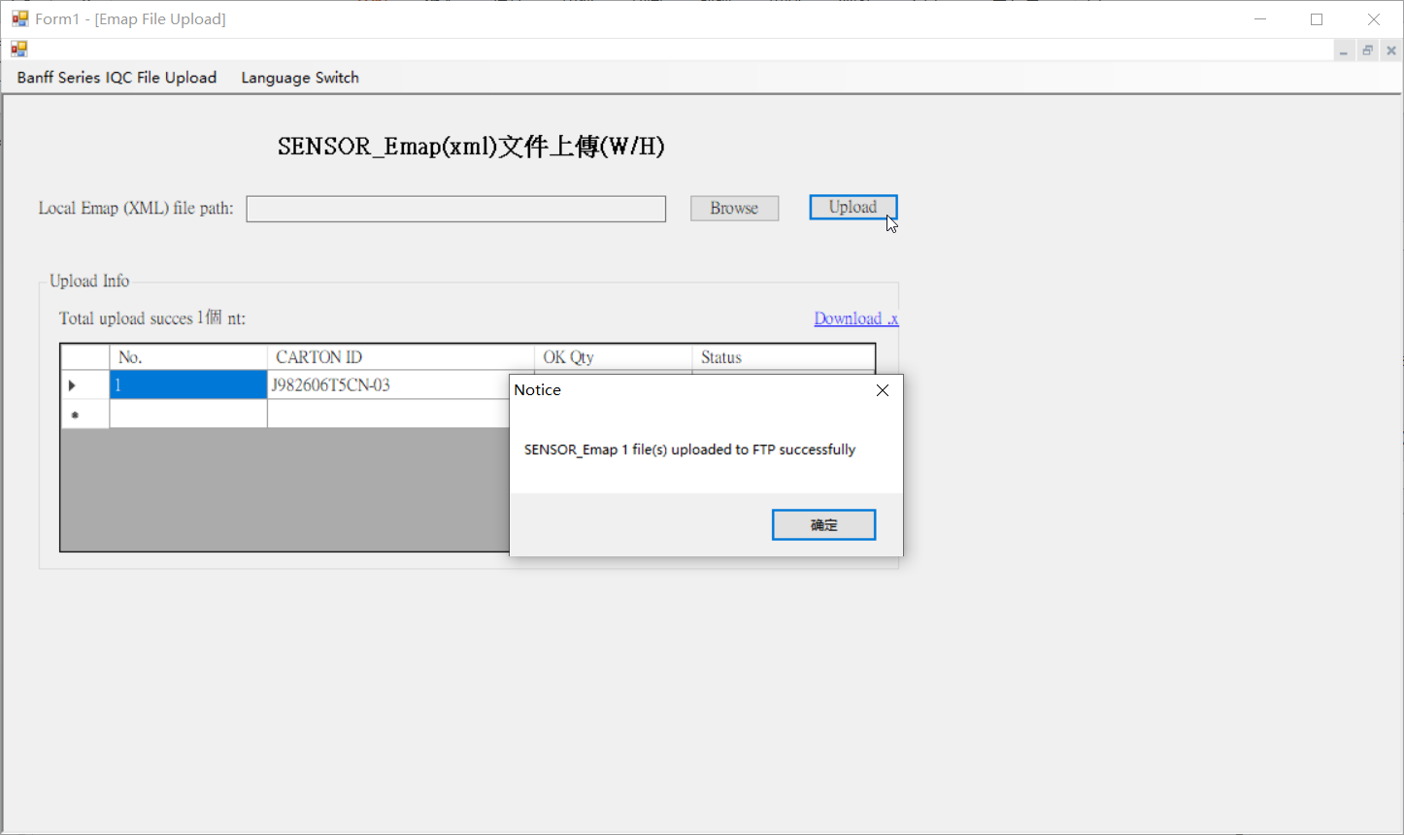
6.点击Upload 6. Click Upload
7.等待几十秒，弹出Upload Successfully就代表上传成功 7. Wait a few tens of seconds, and an "Upload Successfully" pop-up will indicate that the upload was successful.

Slide 5
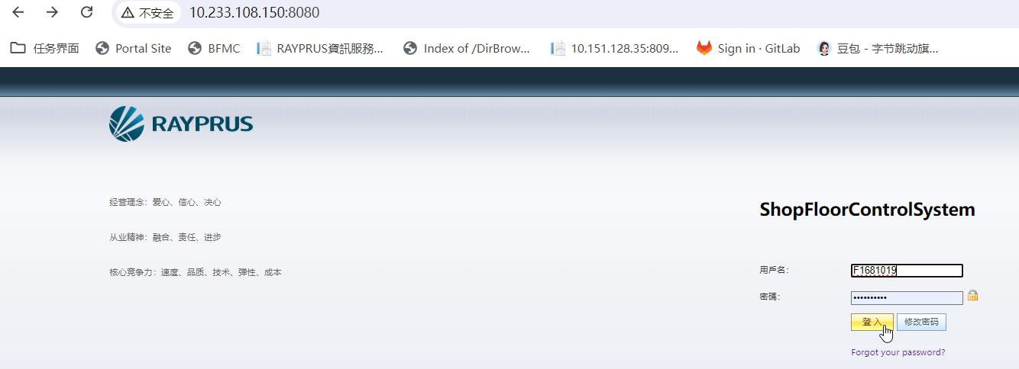
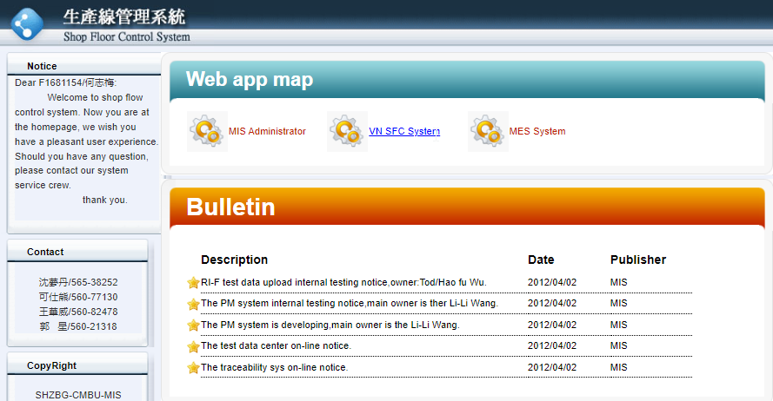
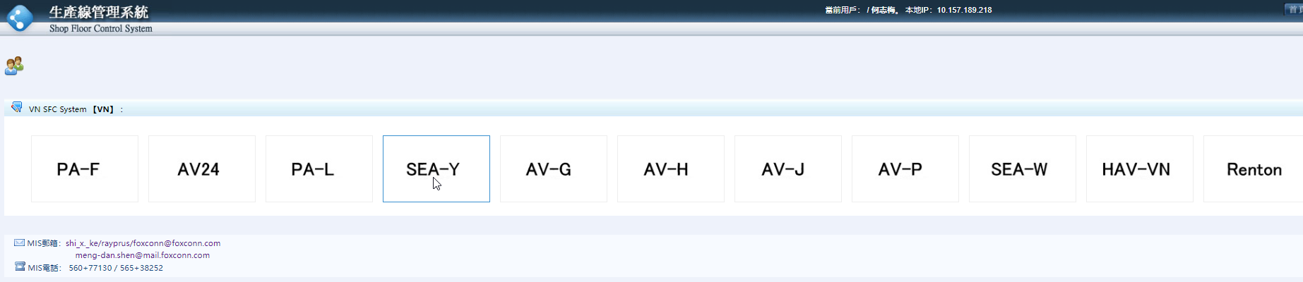
Webaddress：http://10.233.108.150:8080/
Path：VN SFC Systerm/SEA-Y/Product Data/Mapping 資料總查詢

Slide 6
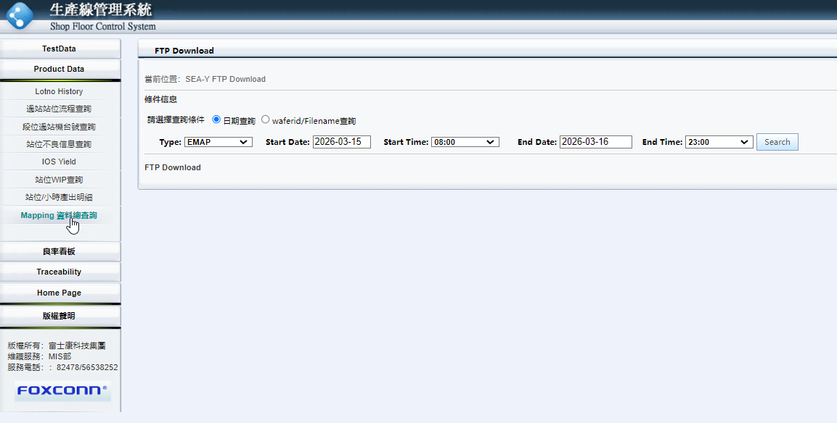
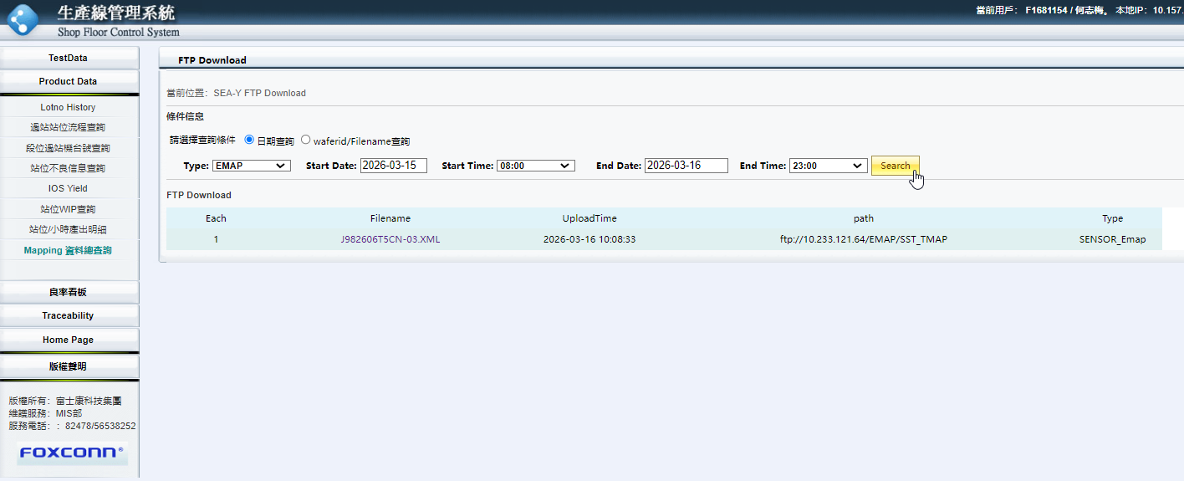
点击Search可以查询已上传记录 Click "Search" to view uploaded records.

